Slide 1
Elastic Stack service
By Puspa Khanal
Notes:
Elastic Stack is a group of open source products from Elastic designed to help users take data from any type of source and in any format and search, analyze, and visualize that data in real time. ... Elastic Stack can be deployed on premises or made available as Software as a Service (SaaS).

Slide 2
ELK Architecture
Notes:
SaaS, Self-Managed
Elasticsearch and Kibana
get ready to dive into data ingestion using the following methods: Elastic Beats, Logstash, Language clients, Kibana Dev Tools
X-Pack is an Elastic Stack extension that provides security, alerting, monitoring, reporting, machine learning, and many other capabilities. By default, when you install Elasticsearch, X-Pack is installed.

Slide 3
Elasticsearch
Elasticsearch is a search engine based on the Lucene library. It provides a distributed, multitenant-capable full-text search engine with an HTTP web interface and schema-free JSON documents.

Slide 4

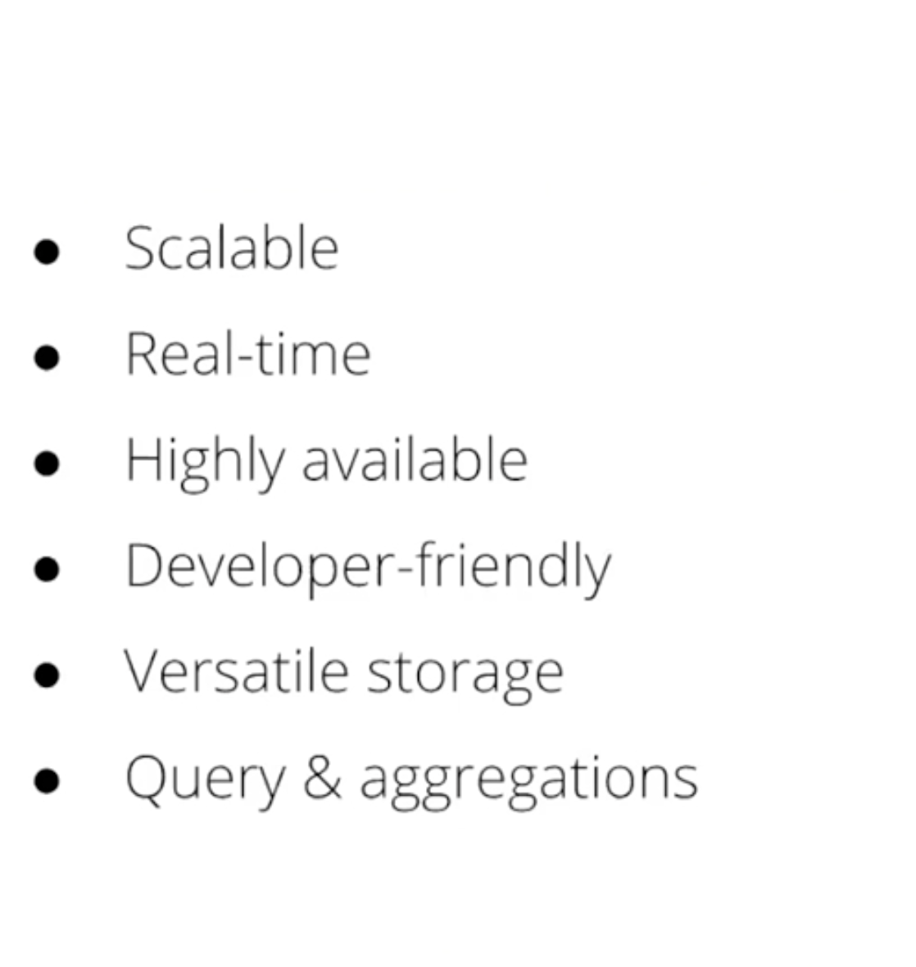
Elasticsearch

Slide 5
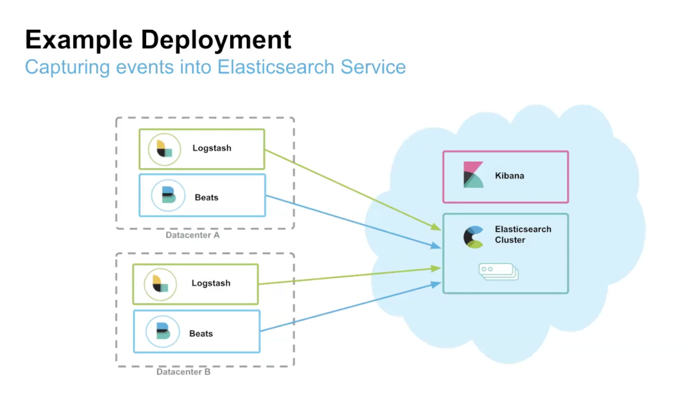

Slide 6
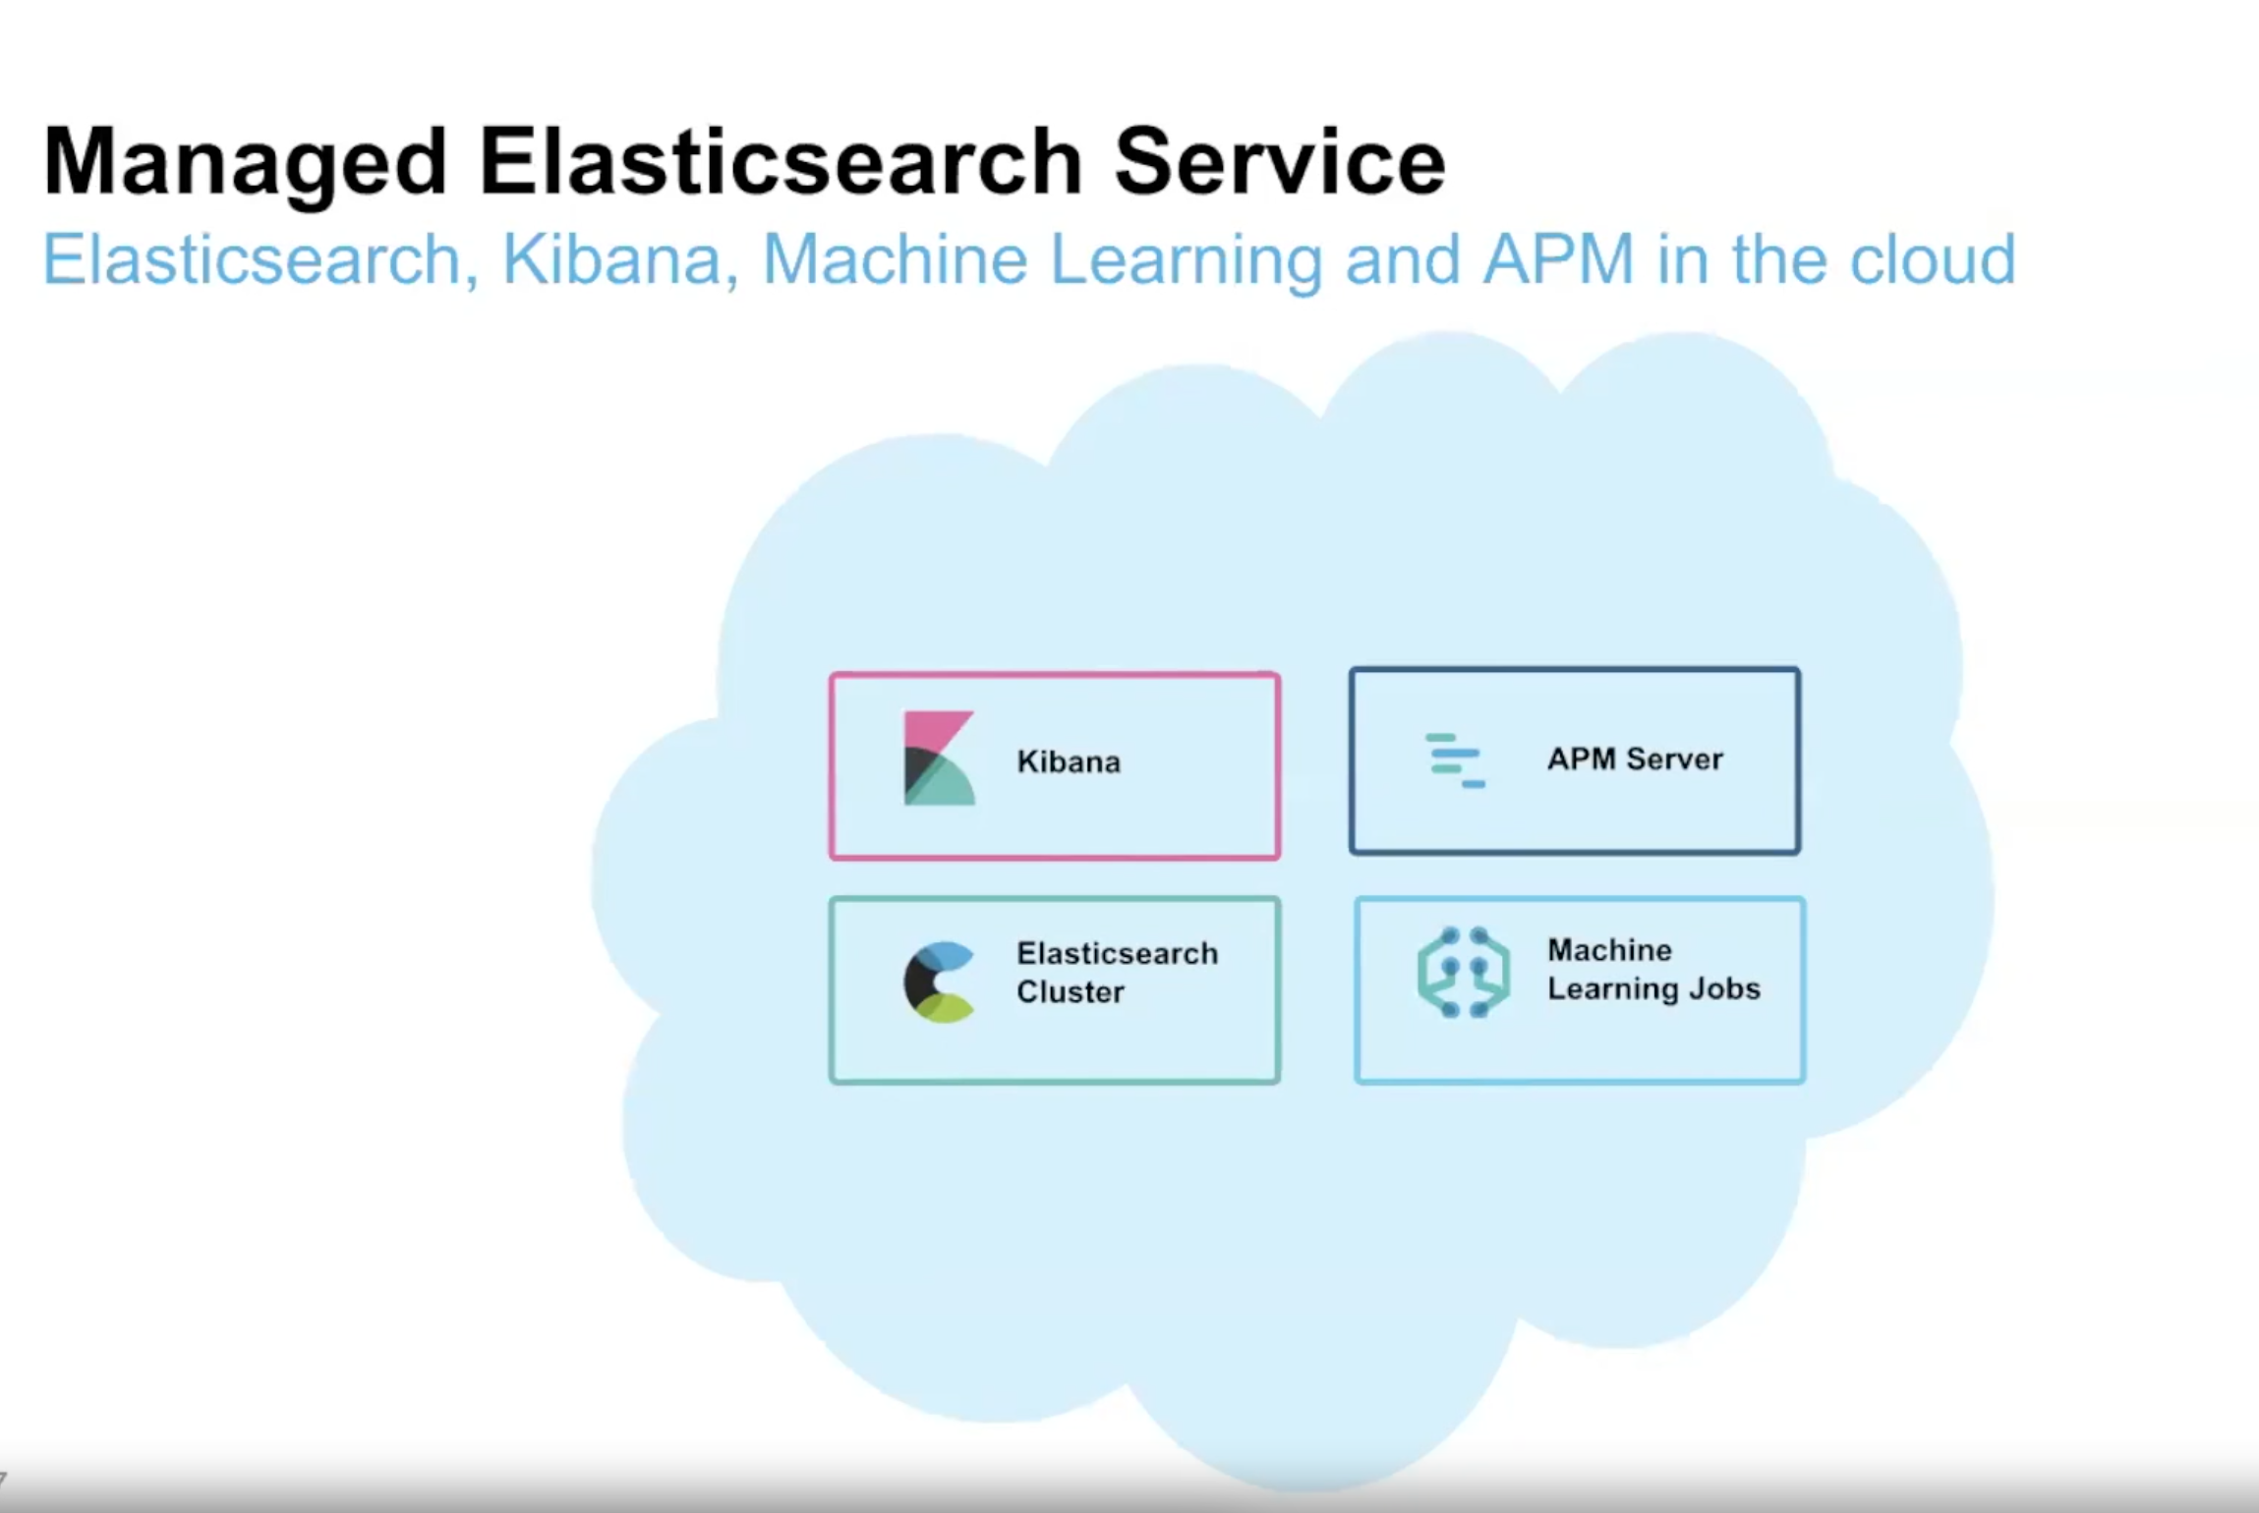

Slide 7
Logstash
Logstash is a powerful and flexible tool to read, process, and ship data of any kind.
Logstash provides a number of capabilities that are not currently available or too costly to perform with Beats, such as enriching documents by performing lookups against external data sources.
A common architectural pattern is to combine Beats and Logstash: use Beats to collect data and use Logstash to perform any data processing that Beats are not capable of doing.
Logstash works by executing event processing pipelines, whereby each pipeline consists of at least one of each of the following: Inputs, Filters and Outputs.
Notes:
Inputs read from data sources. Many data sources are officially supported, including files, http, imap, jdbc, kafka, syslog, tcp, and udp.
process and enrich the data in various ways. In many cases, unstructured log lines first need to be parsed into a more structured format. Logstash therefore provides, among others, filters to parse CSV, JSON, key/value pairs, delimited unstructured data, and complex unstructured data on the basis of regular expressions (filters).
write the parsed and enriched data to data sinks and are the final stage of the Logstash processing pipeline.

Slide 8
Beats
Elastic Beats are a set of lightweight data shippers that allow to conveniently send data to Elasticsearch Service. Being lightweight, Beats do not incur much runtime overhead and they can therefore run and collect data on devices with limited hardware resources, such as IoT devices, edge device, or embedded devices.
Beats come in various flavors to collect different kinds of data: Filebeat, Metricbeat, heartbeat, Functionbeat and some more…..
Notes:
Lot---------The internet of things
Filebeat allows you to read, preprocess and ship data from sources that come in the form of files. supports a number of other data sources including TCP/UDP, containers, Redis, and Syslog. An abundance of modules ease the collection and parsing of log formats for common applications such as Apache, MySQL, and Kafka.
Metricbeat collects and preprocesses system and service metrics. System metrics include information about running processes, as well as CPU / memory / disk / network utilization numbers.
Heartbeat uses probing to monitor the availability of systems and services. Heartbeat is therefore useful in a number of scenarios such as infrastructure monitoring and security analytics. ICMP, TCP, and HTTP are supported protocols.
Functionbeat collects logs and metrics from within a serverless environment such as AWS Lambda.

Slide 9
Kibana
Kibana is an open source data visualization dashboard for Elasticsearch.
It provides visualization capabilities on top of the content indexed on an Elasticsearch cluster.
Users can create bar, line and scatter plots, or pie charts and maps on top of large

Slide 10

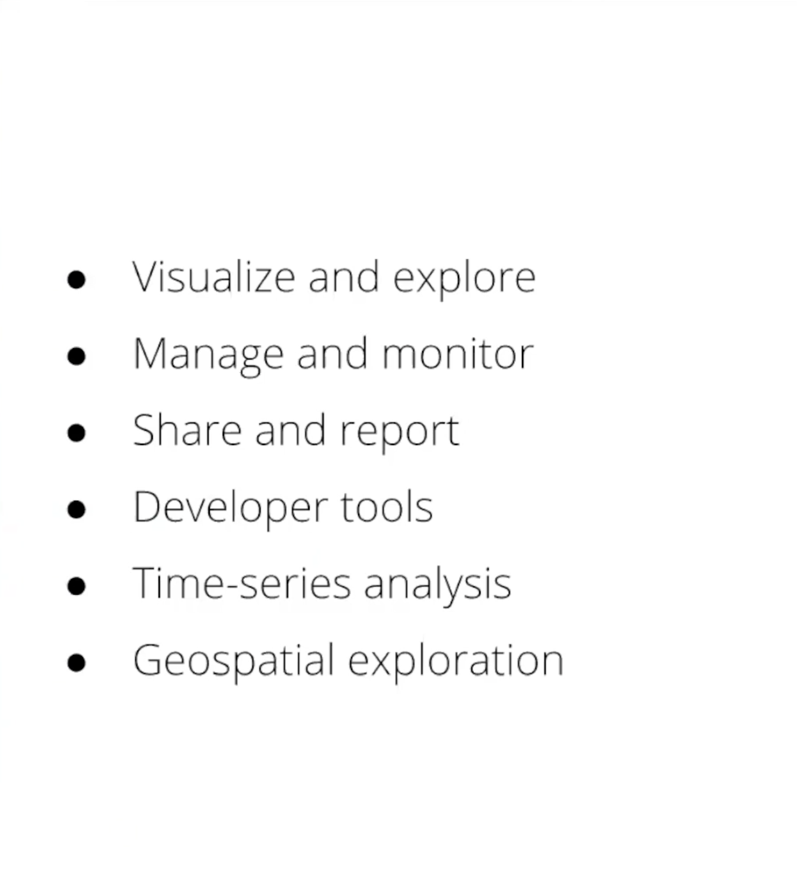
Kibana

Slide 11
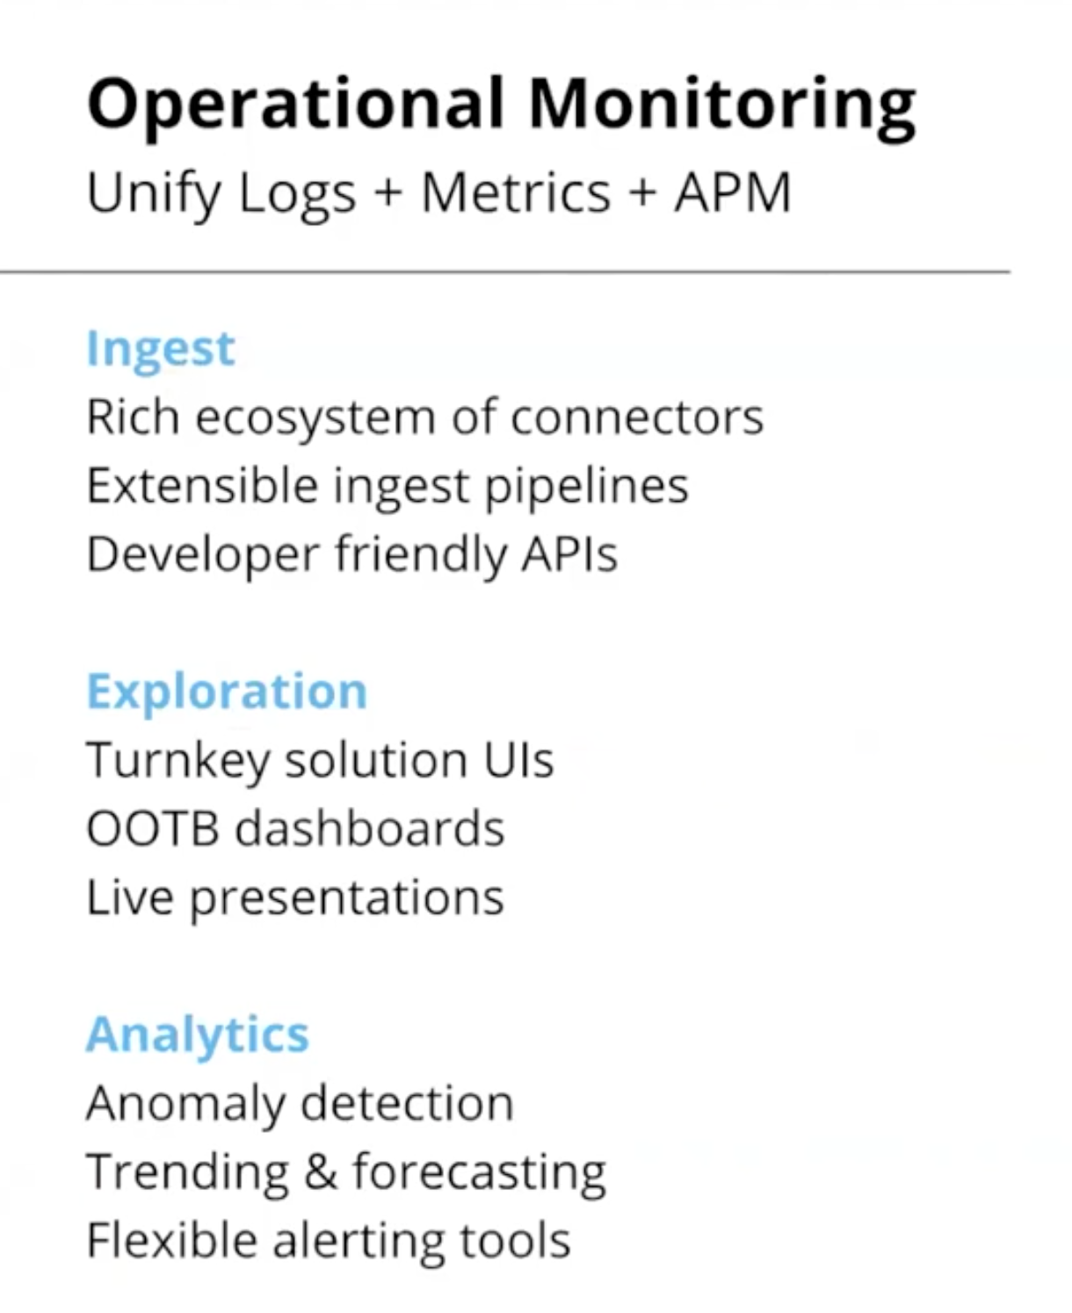
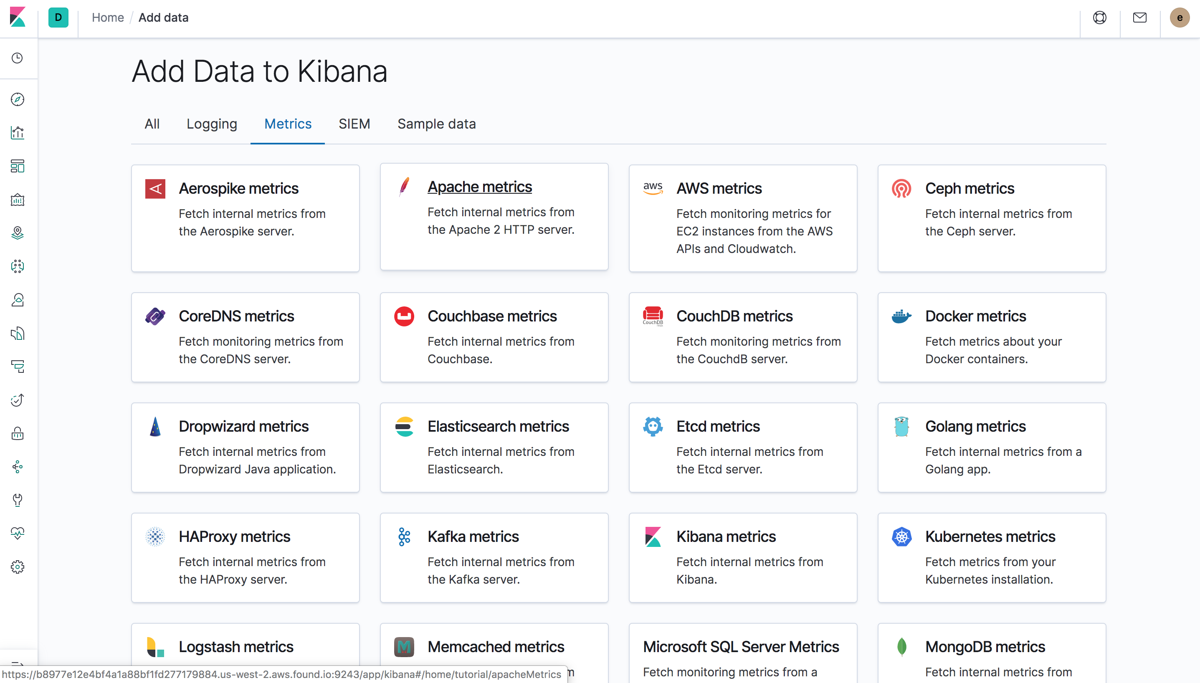
Notes:
Out of the box
Application performance management

Slide 12
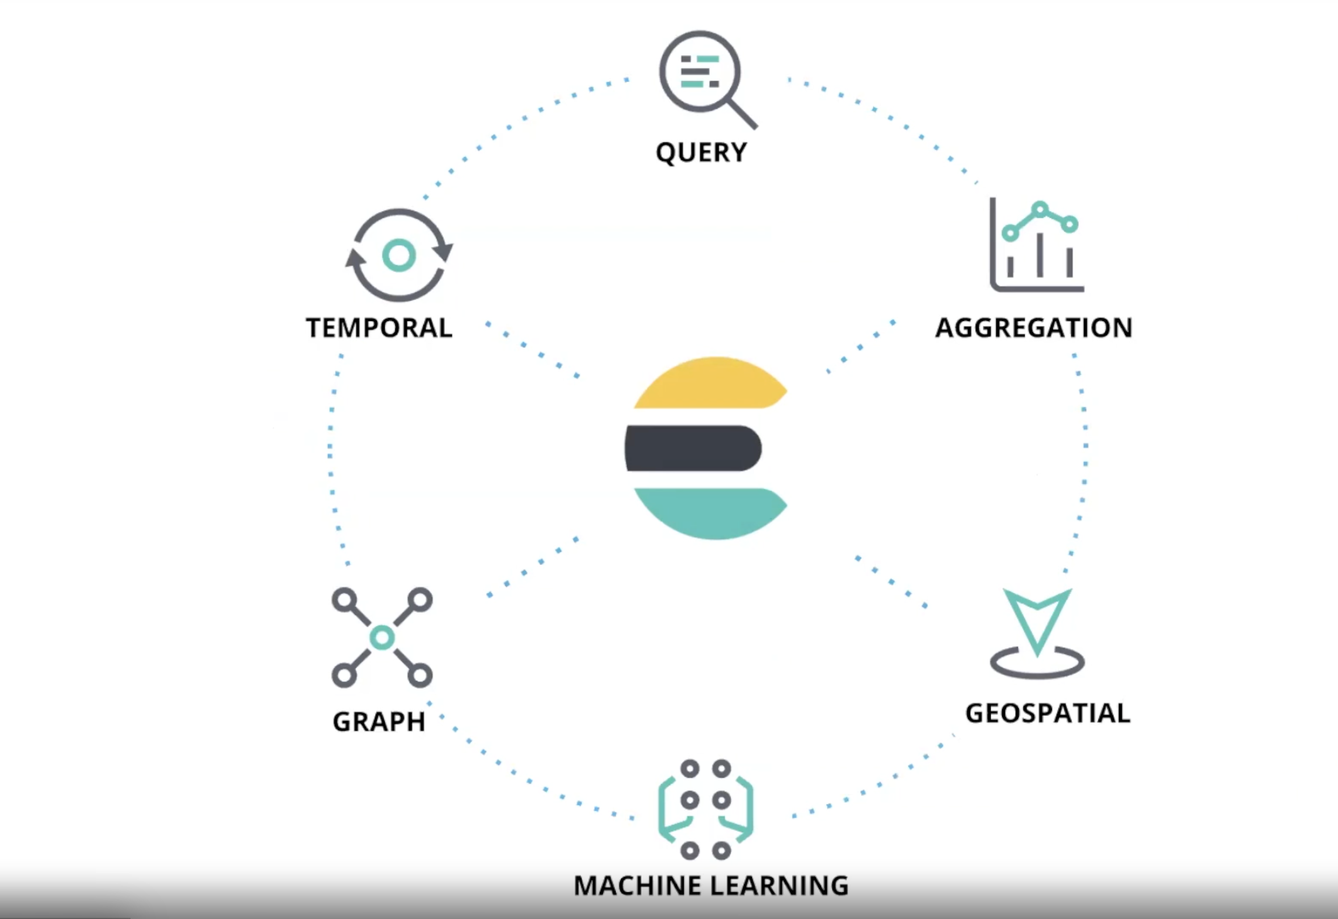
Notes:
Aggregation---- refers to the collection of documents or a set of documents obtained from a particular search query or filter.
Temporal - s the default behavior of Elastic machine learning, unless you specifically define the analysis to be population-based
Is a comparison of the behavior of an entity with respect to itself over time.
GEOSPITAL- Introducing Maps, a new Kibana application for geospatial analysis. Geo data is everywhere and is an integral part of a multitude of use cases. Backed by Elasticsearch, Maps enables you to analyze your geo data in real time, at scale, like never before.

Slide 13
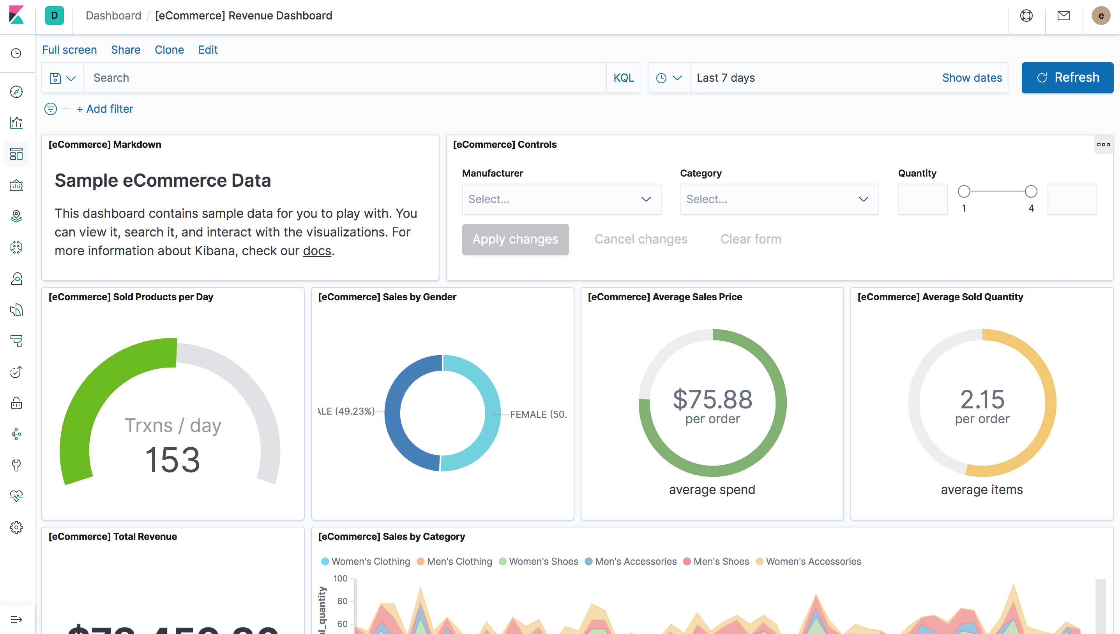
All the Visualizations you expect, and then some more

Slide 14
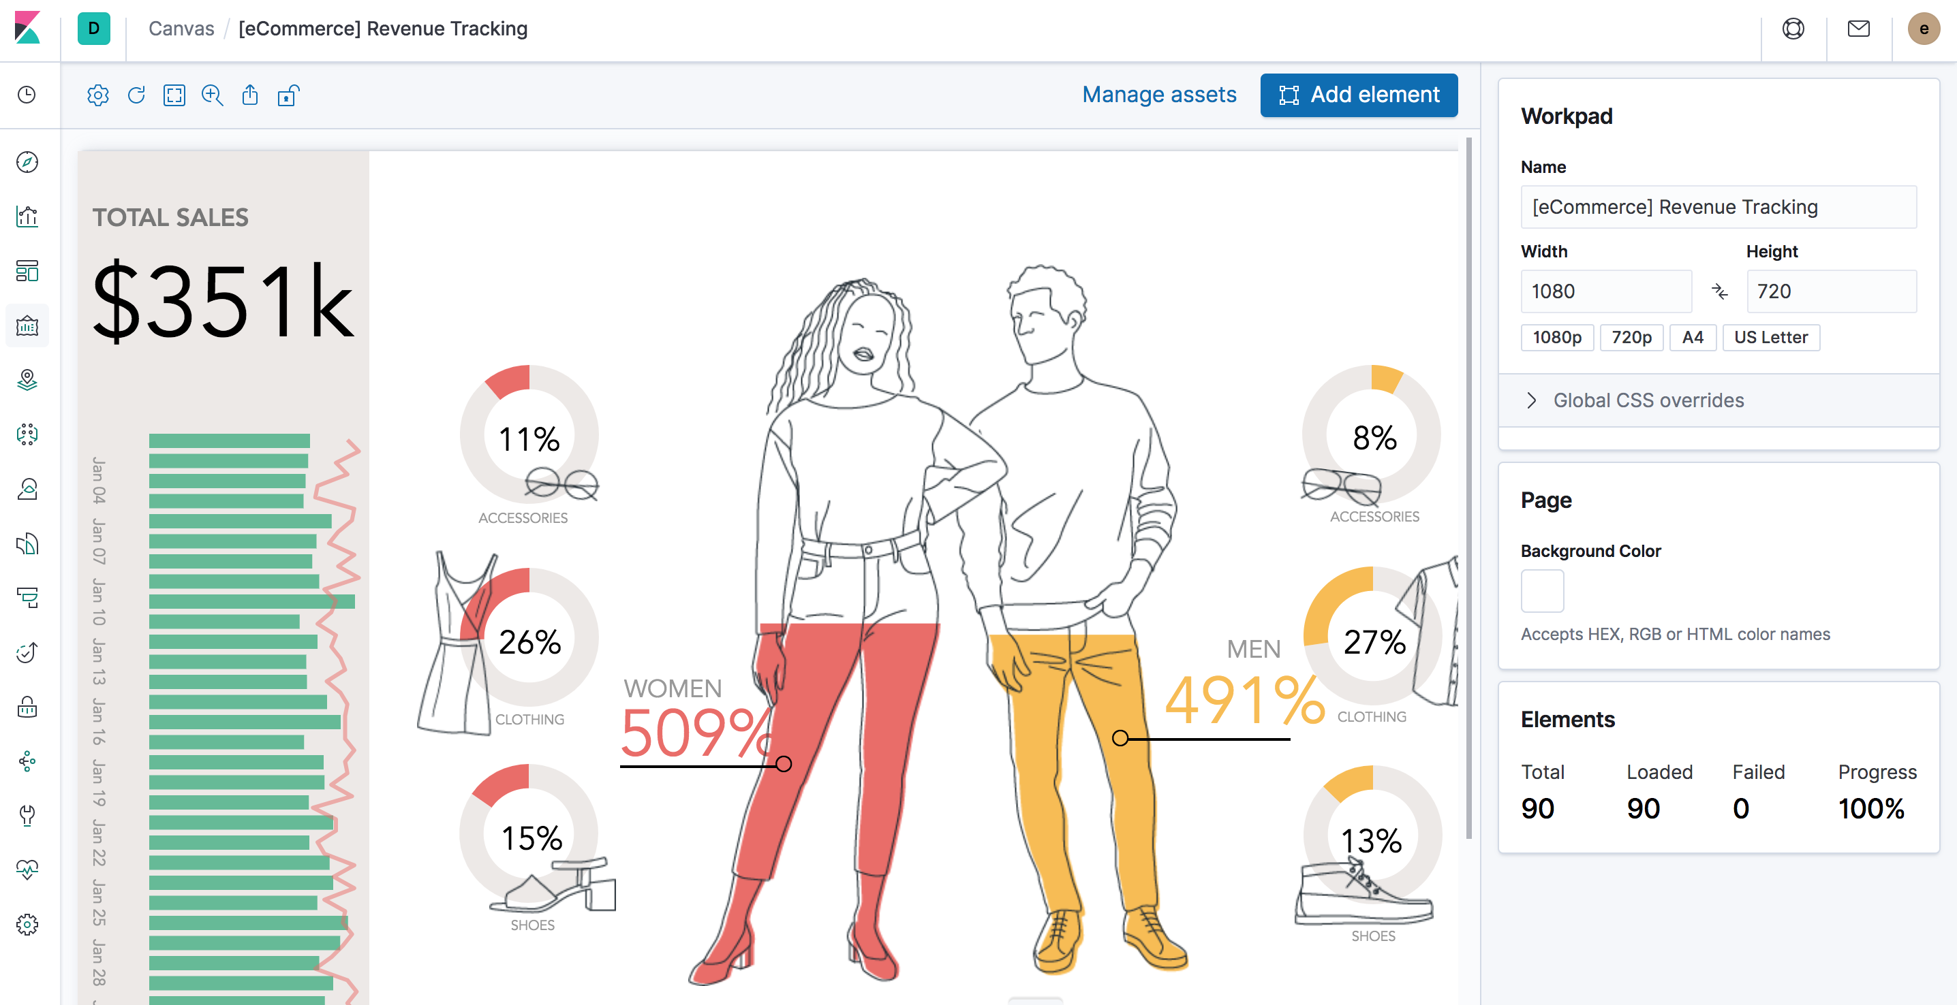
Create live pixel-perfect presentations using Canvas

Slide 15
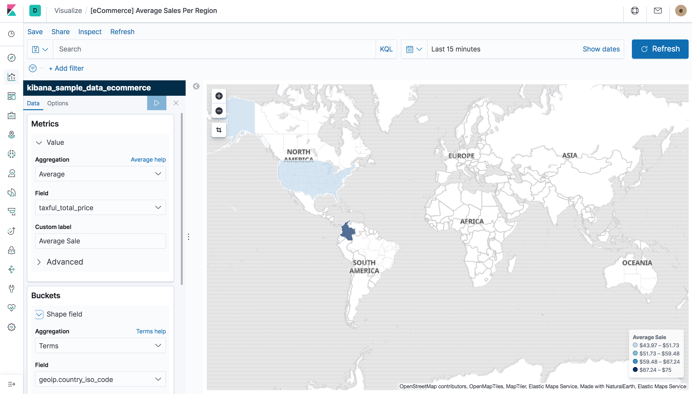
Explore geo data on maps, powered by Elastic Maps Service

Slide 16
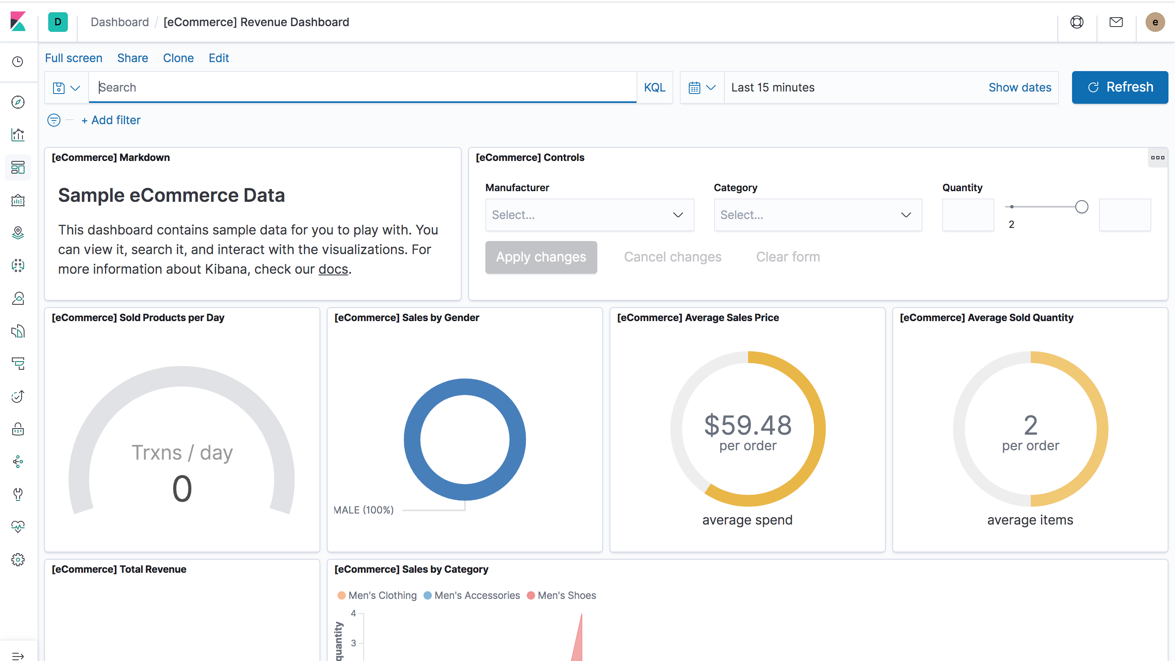
OOTB dashboards for 50+ (and growing) data sources
Notes:
Out of the box

Slide 17
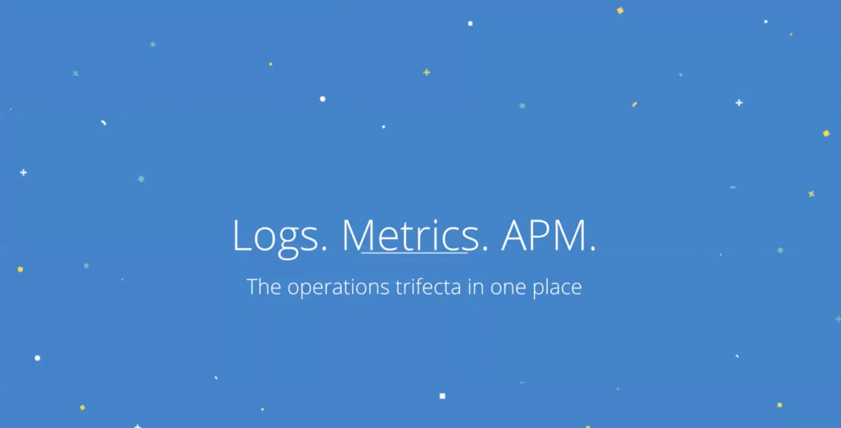
Notes:
Application performance management

Slide 18
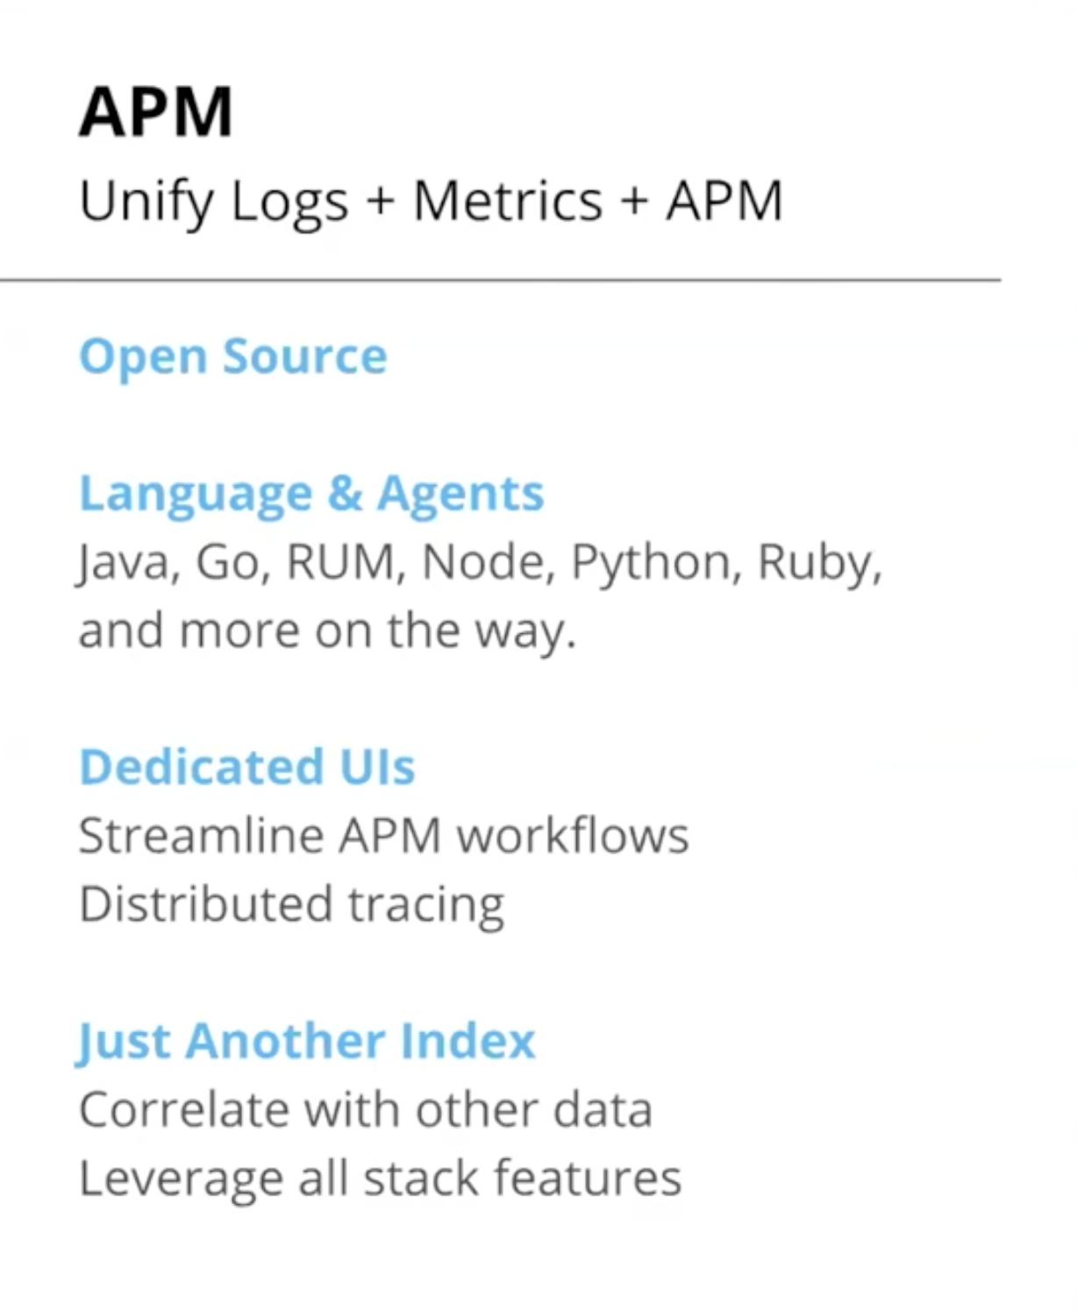

APM
Notes:
Application performance management

Slide 19
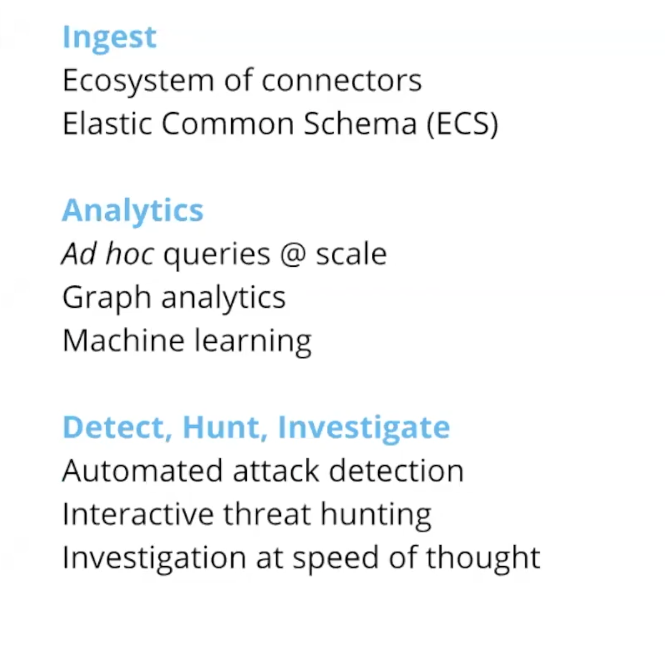
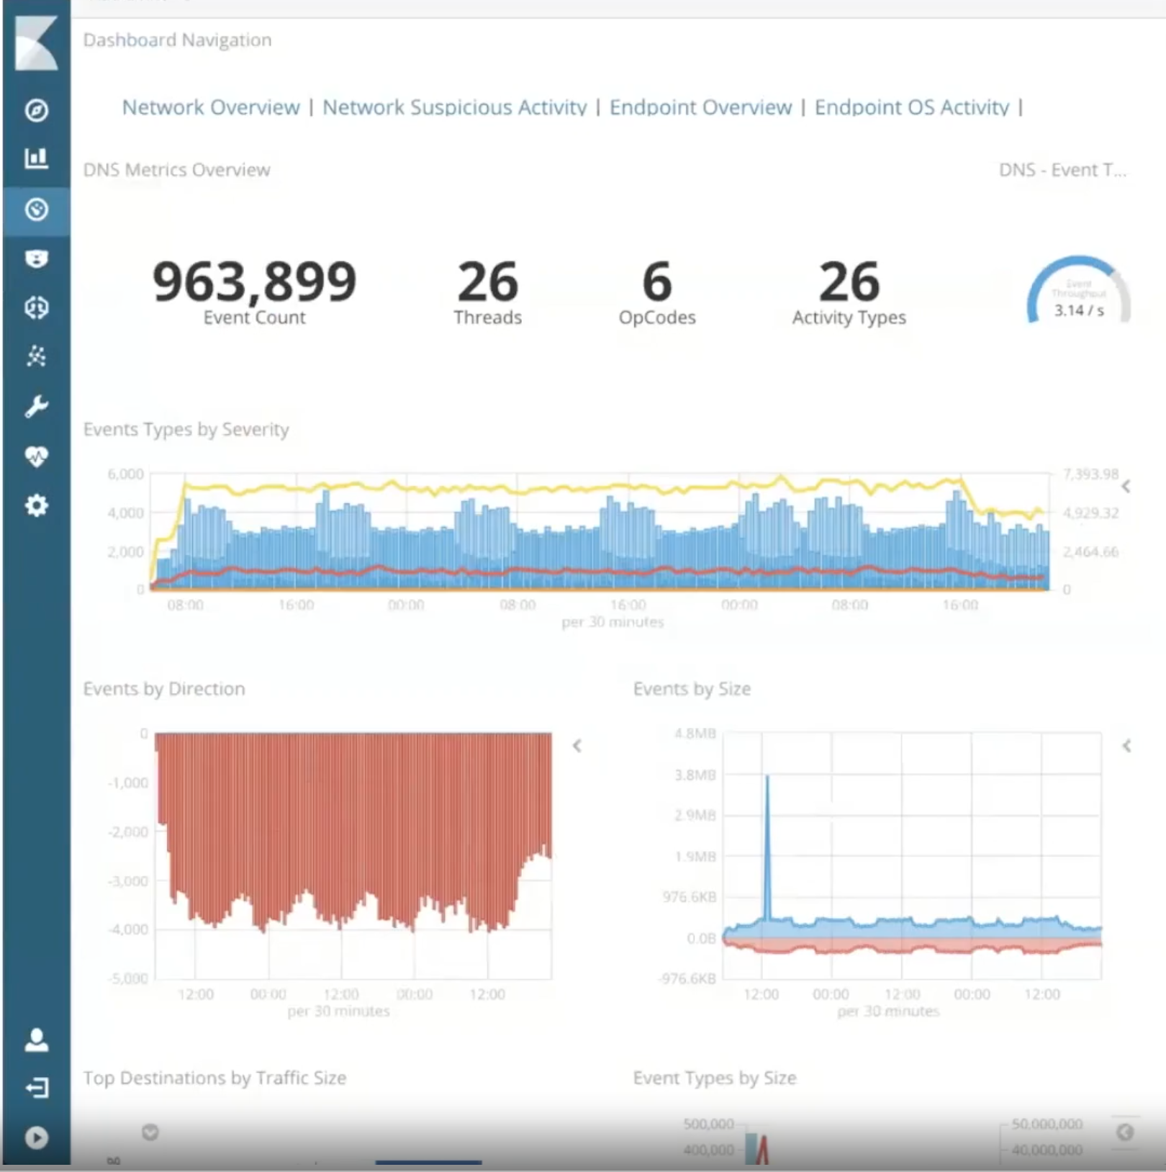
Security Analytics Same data. Different questions.

Slide 20


Slide 21
Elastic App Search Service powered by Swiftype, build on the Elastic Stack
A powerful set of APIs and developer tools designed for developers building rich, user-facing search Applications
Out-of-the box features include:
Optimized relevance for search use cases
Typo-tolerance
Relevance tuning
First-party API Clients and robust APIs
Detailed API Logs &Analytics
Automatic Scaling & Operational Support

Slide 22
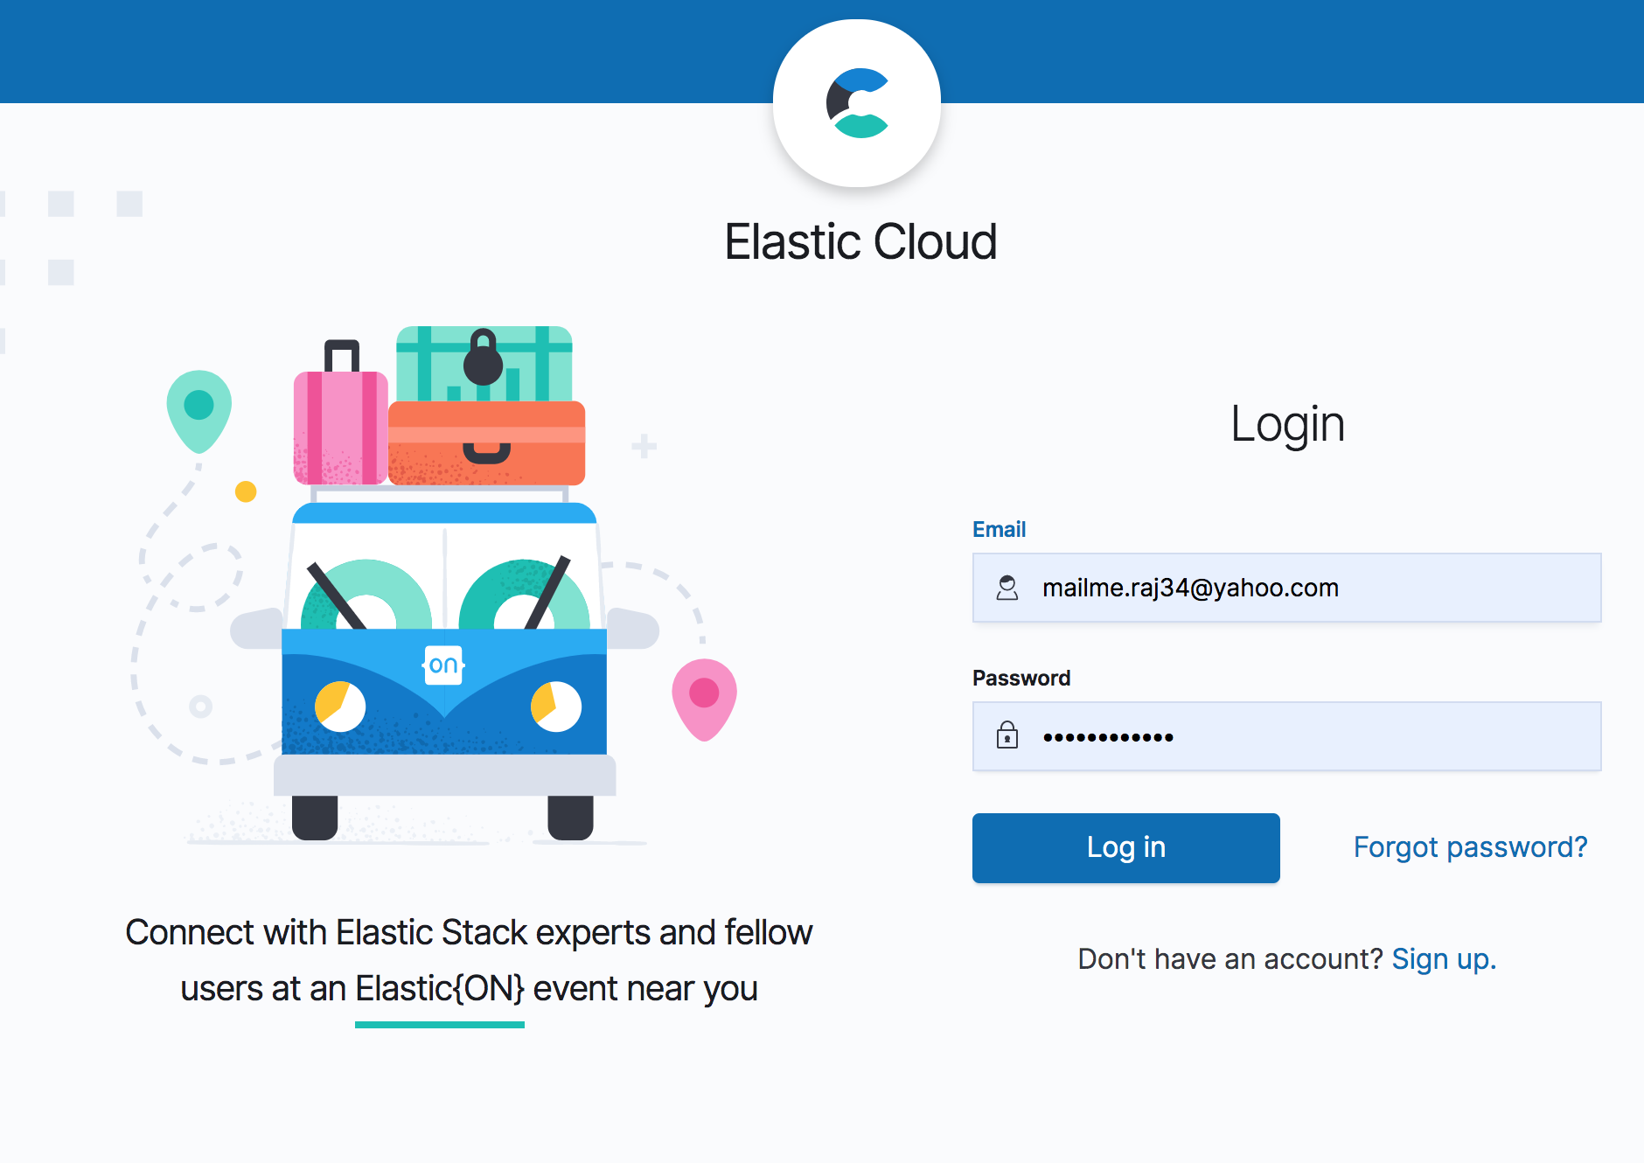
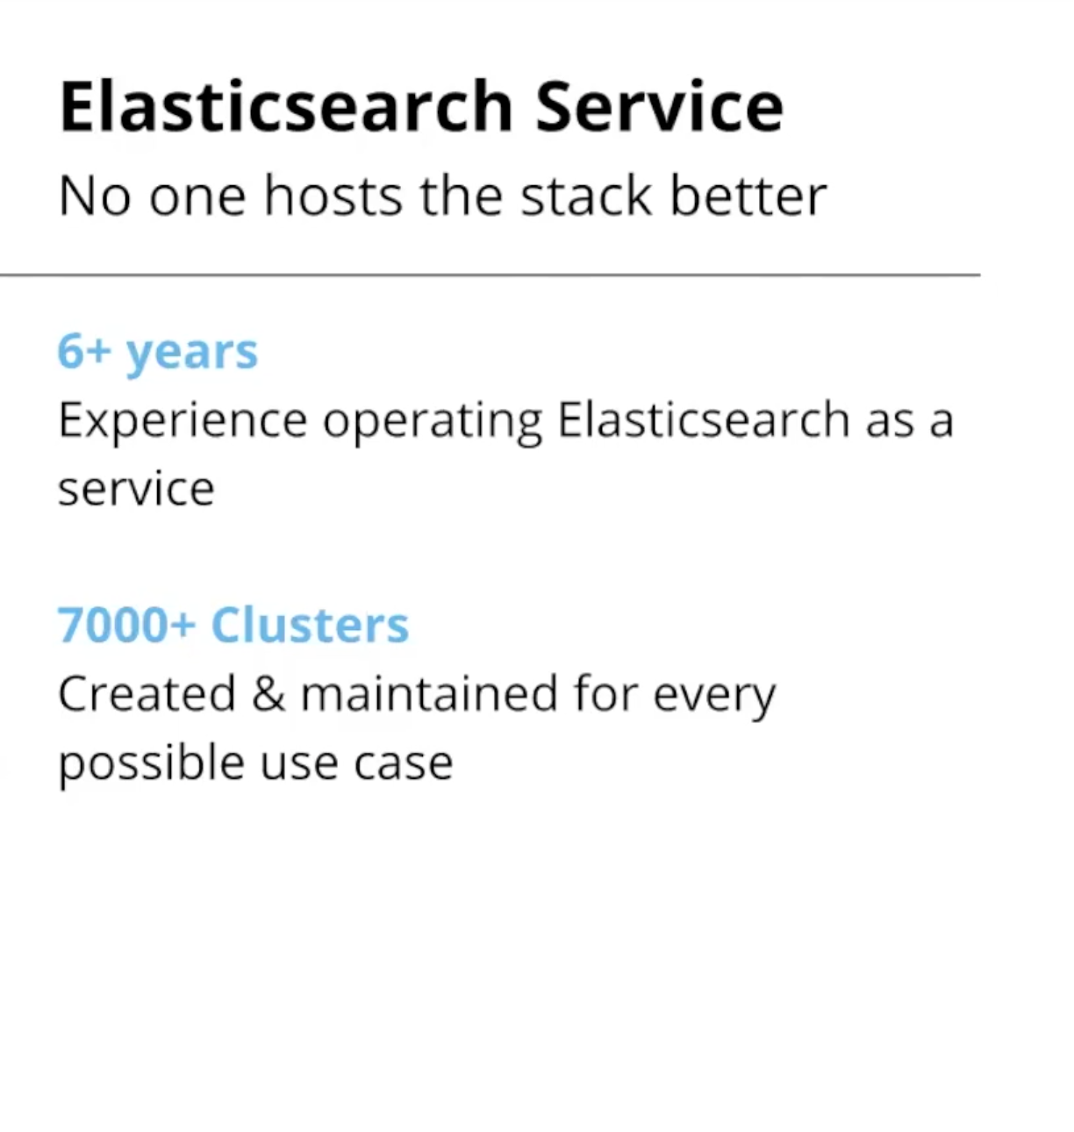

Slide 23
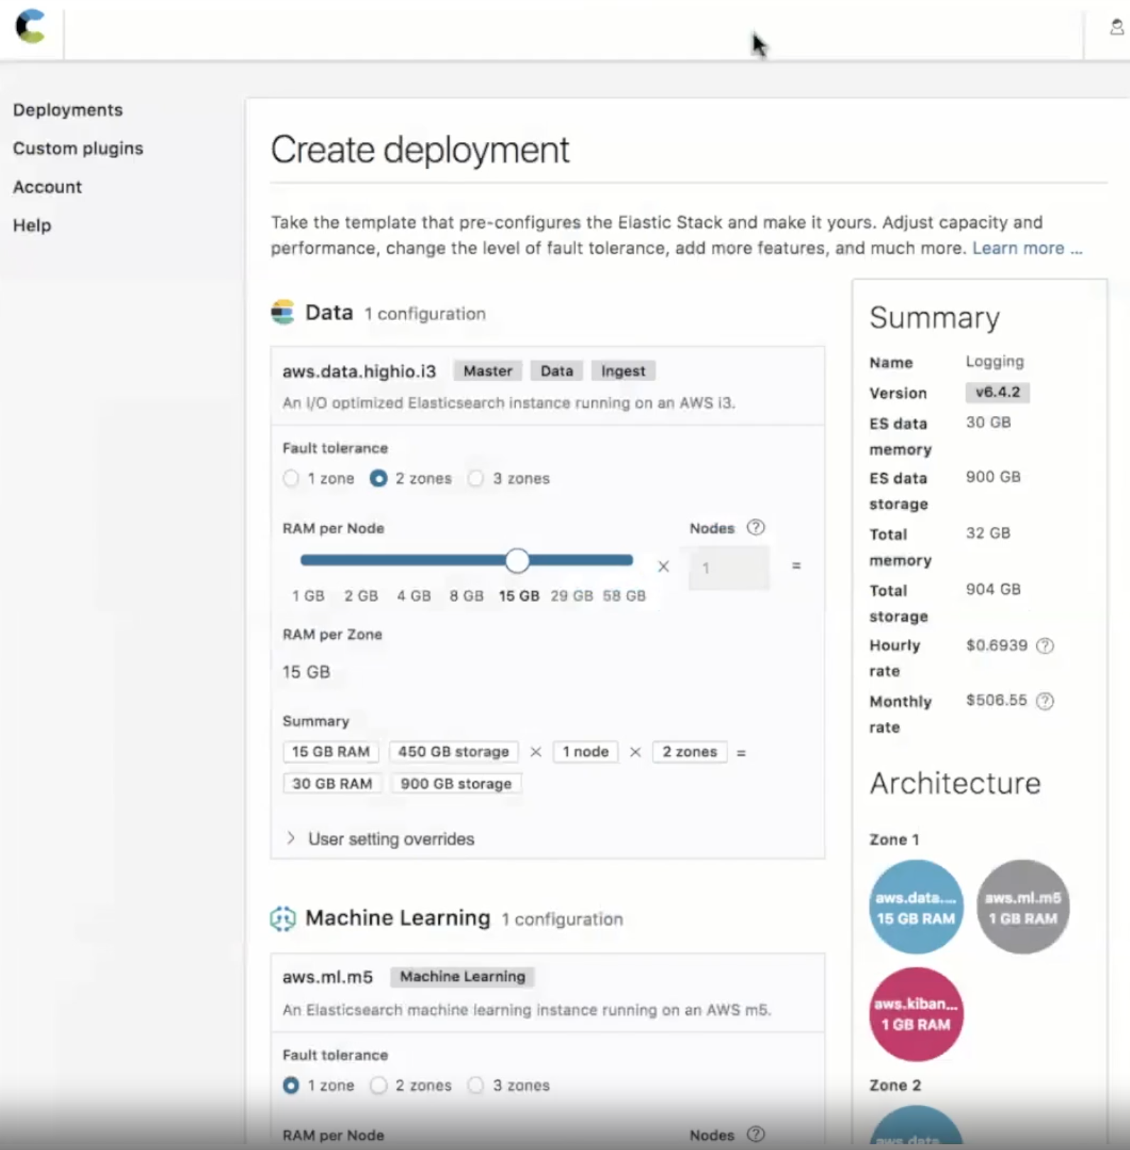
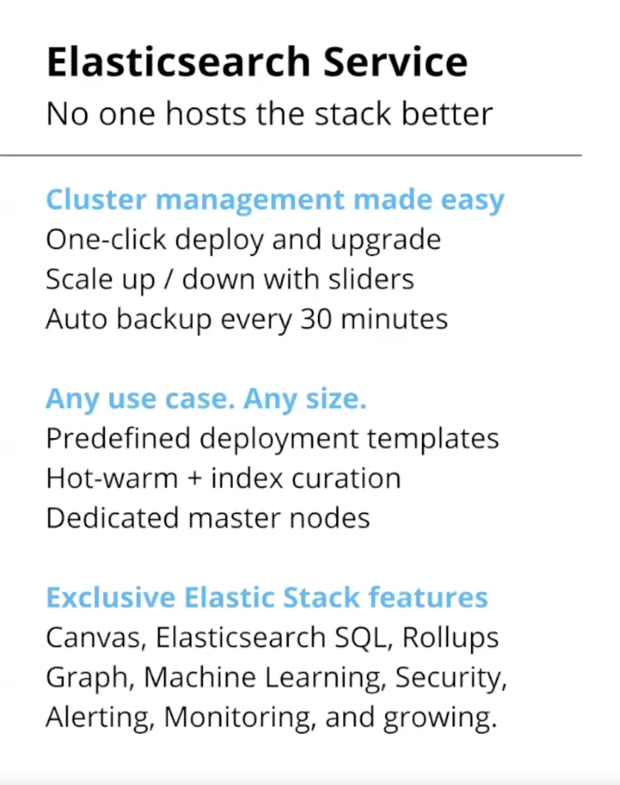

Slide 24
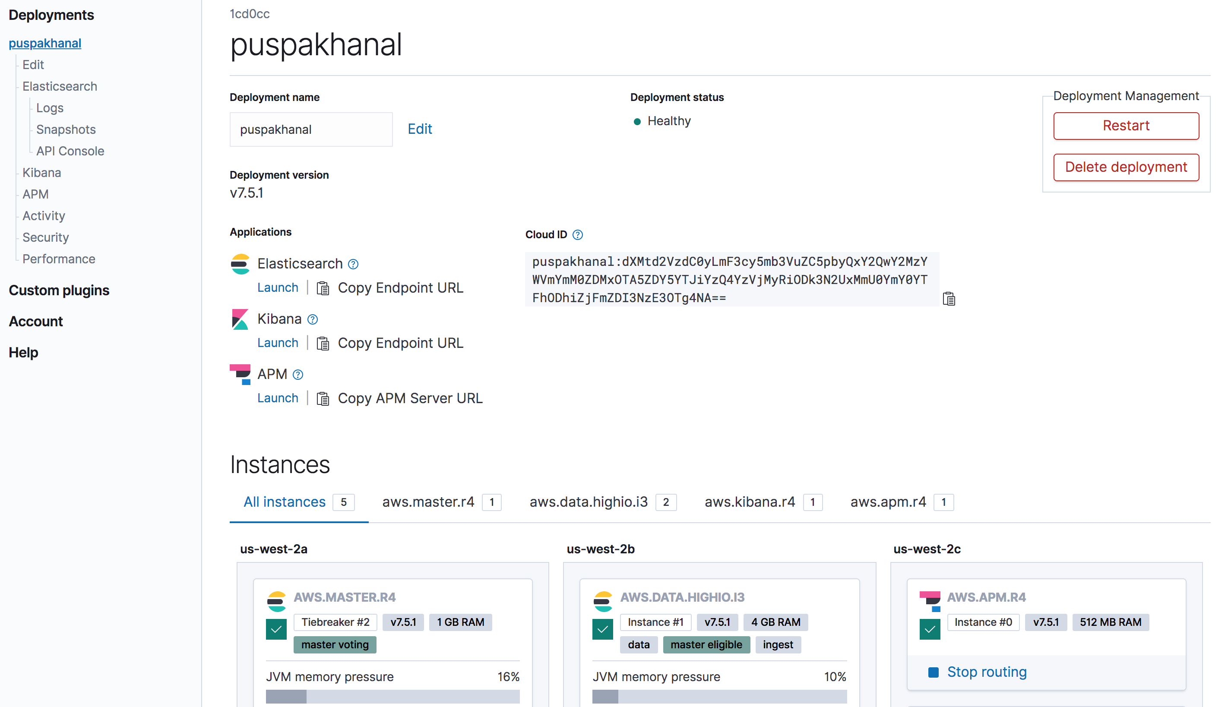

Slide 25
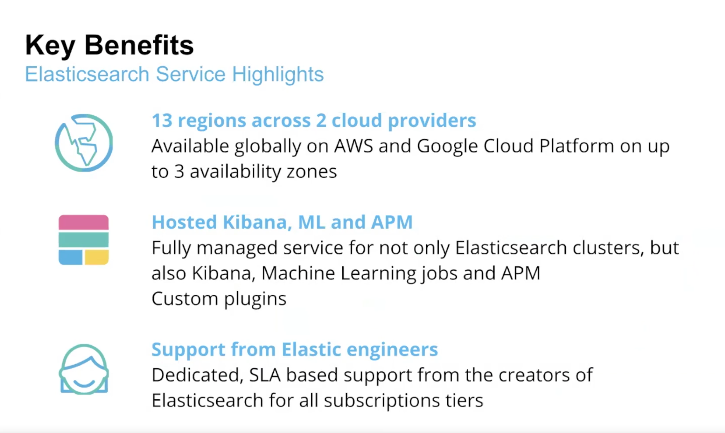
Notes:
service-level agreement

Slide 26
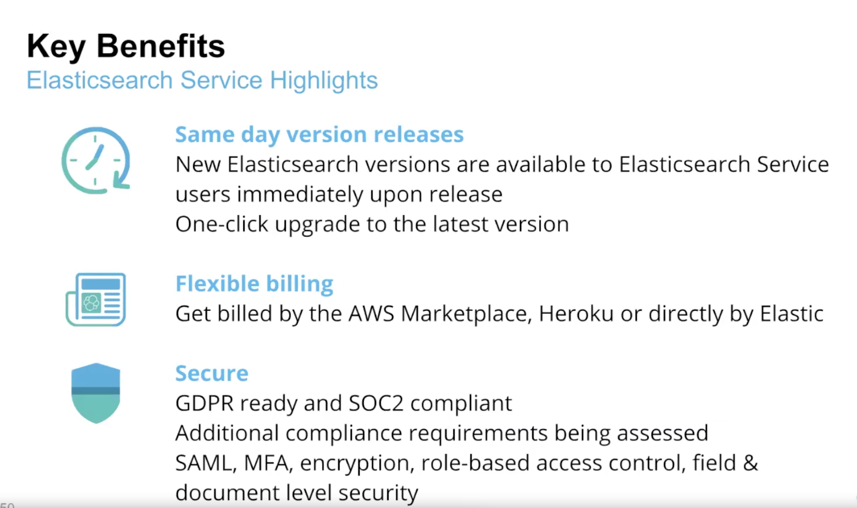
Notes:
General Data Protection Regulation
Service Organization Control
Security Assertion Markup Language

Slide 27


Slide 28
Video ELK
https://qbox.io/blog/welcome-to-the-elk-stack-elasticsearch-logstash-kibana

Slide 29
Discussion
Questions
Concerns
Suggestions

